Slide 1
Series / Parallel Circuit
Current=X
Current=Y
+
BATTERY
LED
Current=X
LED
LED
-
LED
Current=Y/2
Current=X
Current=Y
Series
Parallel

Slide 2
Conducting or Non-Conducting Material
+
LED
BATTERY
Connectors
-

Slide 3

Nuclear Fission
Chain Reaction

Slide 4
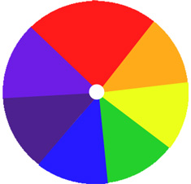
Newton's Color Disk

Slide 5
Potentiometer – a variable resistor
Potentiometer
LED
LED
BATTERY
+
-

Slide 6
Switches in Series combination
Switch
Switch
LED
BATTERY
+
-

Slide 7
Switches in Parallel combination
LED
Switch
Switch
BATTERY
+
-

Slide 8
Working of Capacitor
Switch
Switch
Capacitor
LED
BATTERY
+
-
Charging Loop
Discharging Loop

Slide 9
Capacitors in Series combination
Capacitor
Capacitor
Switch
LED
BATTERY
+
-

Slide 10
Capacitors in Parallel combination
Switch
Capacitor
Capacitor
LED
BATTERY
+
-

Slide 11
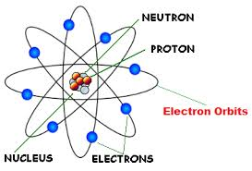
Rutherford atomic model

Slide 12
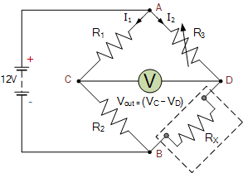
Wheatstone Bridge
At Balance:
R1
R2
=
R3
Rx
9V
9V
R2 X
R3
=>Rx
=
R1

Slide 13
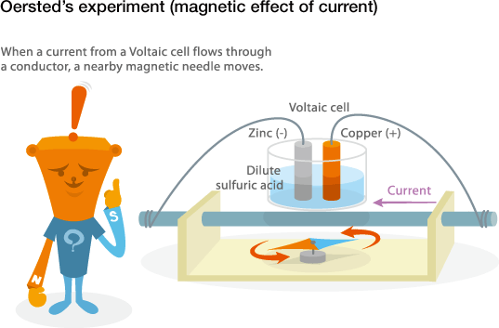

Slide 14
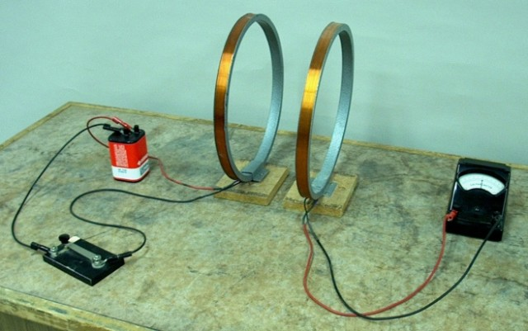

Slide 15
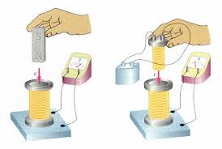

Slide 16
Bohr Atomic Model of Nitrogen Atom
Orbit
e-
e-
e-
Electron
Proton
+
e-
e-
e-
Nucleus
e-
Neutron

Slide 17
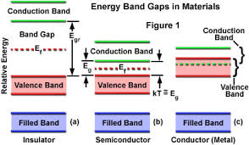

Slide 18
Working of Diode
No Current
Current
LED
Diode
Diode
LED
BATTERY
BATTERY
+
-
+
-
Forward Biased
Current flows
Reverse Biased
Current does not flow

Slide 19
Diode as a Switch
No Current
Current
LED
Diode
Diode
LED
BATTERY
BATTERY
+
-
+
-
Forward Biased
Current flows
Reverse Biased
Current does not flow

Slide 20
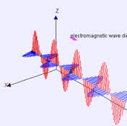

Slide 21
Electronic Piano
+
BATTERY
-
Speaker

Slide 22
Light Dependent Resistor
LDR
LED
BATTERY
+
-

Slide 23
Electromagnetic Induction

Slide 24
Steady Hand Tester
Wire Loop
BUZZER
BATTERY
+
-
BUZZER

Slide 25

Relay and Electromagnetism
Switch
LED
Normal Open Loop
+
BATTERY
BATTERY
+
-
Trigger Loop
-
Normal Connected Loop
LED

Slide 26
Application of Relay as a switch
Switch
LED
Normal Open Loop
+
BATTERY
BATTERY
+
-
Trigger Loop
-
Normal Connected Loop
LED

Slide 27
Law of Reflection
Normal
i
r
Incident ray
Reflected ray
<i = <r
Mirror

Slide 28
Law of Refraction
Normal
Incident ray
i
medium 1
Air
Water
medium 2
r
Refracted ray

Slide 29
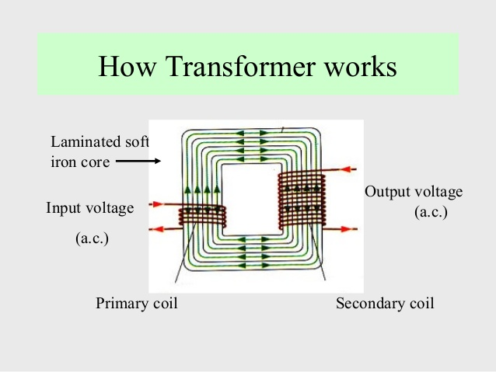
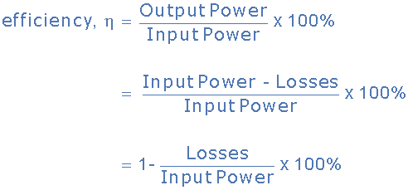

Transformer Efficiency

Slide 30
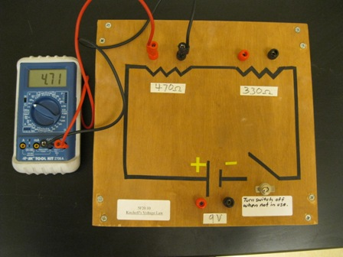
Kirchhoff’s Voltage Law

Slide 31
Kirchhoff’s Current Law

Slide 32
OHM’S Law

Slide 33
Potentiometer as Voltage Divider

Slide 34
Charging and Discharging of Capacitor with Resistors with various values

Slide 35
Zener Diode as Voltage Regulator

Slide 36
Transistor as Switch

Slide 37
NPN Transistor

Slide 38
PNP Transistor

Slide 39
Transistor Types NPN and PNP

Slide 40
Identifying the type of Bipolar Junction Transistor

Slide 41
AC Generator

Slide 42
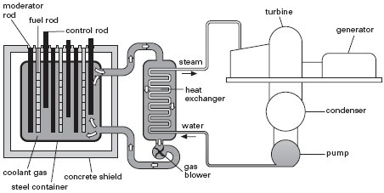
Nuclear Reactor

Slide 43
Communication System

